Slide 1
Cybersecurity Portfolio
Vulnerability Scanning
TryHackMe
Vulnerability Scanning Tools
ITECH1502 Cybersecurity Fundamentals
Jane Armstrong • Student ID: 30155016 • 15 October 2026
Notes:
Opening: Introduce yourself and explain that this presentation covers a practical vulnerability-scanning exercise. Replace all placeholders before presenting.

Slide 2
PROJECT OVERVIEW
Why vulnerability scanning?
TryHackMe practical exercise: Vulnerability Scanning Tools
The challenge
Project objectives
Why it matters
Explore how scanning identifies live hosts, exposed services and potential security weaknesses.
• Practice host discovery with Nmap
• Identify ports and service versions
• Explore web checks with Nikto
• Understand OpenVAS reporting and limitations
Poorly secured services can increase attack surface. A scan is a first step in identifying potential weaknesses. It is not proof that a system is vulnerable.
Training environment: TryHackMe virtual machine
Scope: lab target assigned by TryHackMe
Notes:
Explain why scanning matters and state the exact platform, room and scope you used.

Slide 3
REFERENCE • CORE CONCEPTS
Core terminology and scanner types
CORE TERMINOLOGY
Vulnerability
CVE (Common Vulnarabilities and Exposures)
CVSS (Common Vulnarability Scoring System)
Misconfiguration
Software vulnerability
A weakness that could be exploited to bypass security or gain unauthorised access.
A standard severity score from 0–10, higher scores generally need more urgent attention.
Incorrect set up which causes security weaknesses, such as excessive permissions, weak passwords, unsafe default settings.
A flaw in application code or logic that can cause unintended or exploitation.
A unique ID for a publicly known vulnerability, making it easier to track and research.
TYPES OF VULNERABILITY SCANNER
Network scanner
Web application scanner
Host-based scanner
Finds devices and identifies open ports and exposure points on a network
Checks websites and HTTP/HTTPS services for risky behaviour, outdated components and weak configuration.
Examines a system internally for missing patches, outdated software and insecure settings.

Slide 4
METHODOLOGY
Methodology: how I approached the task
Completed workflow across Nmap, Nikto and the provided OpenVAS report
1
2
3
4
5
Prepare
Define scope
Scan
Interpret
Document
Logged in to TryHackMe. Read the room instructions and core terminology. Started the TryHackMe virtual machine.
Used the target IP provided by TryHackMe. I had to restart the VM halfway through the exercise, which gave a different IP address to the first one, so later exercises have a different IP
Ran Nmap host discovery (-sn), port scan (-sV), and aggressive scan(-A).
Used Nikto to check the HTTP service on port 8080
Used OpenVAS to scan for vulnerabilities and weaknesses web application security issues
Interpreted detected ports and services.
Saved scan evidence, reviewed the pre-scanned MyTarget report and recorded its key findings.
Notes:
Walk through your real process in order. Mention only commands and tools you actually used.

Slide 5
TOOL OVERVIEW
Three different scanning tools
The tools complement one another: discover the host, inspect services, then investigate likely weaknesses.
Nmap — network discovery
Nikto — web-server checks
OpenVAS — vulnerability assessment
Purpose
Gain information about the target environment. Find live hosts, services running and open ports.
Commands used
• nmap -sn 10.48.179.89 - host discovery
• nmap -sV 10.48.179.89 – port scanning
• nmap –A 10.48.179.89 – aggressive scan
Purpose
Check a web server for common risky files, information disclosure and configuration issues.
Command used
• nikto -h http://10.49.172.51:8080
Purpose
Run vulnerability tests, group results by severity and associate findings with known vulnerabilities.
In this lab
Reviewed the supplied MyTarget pre-scanned report; a new scan was not run.

Slide 6
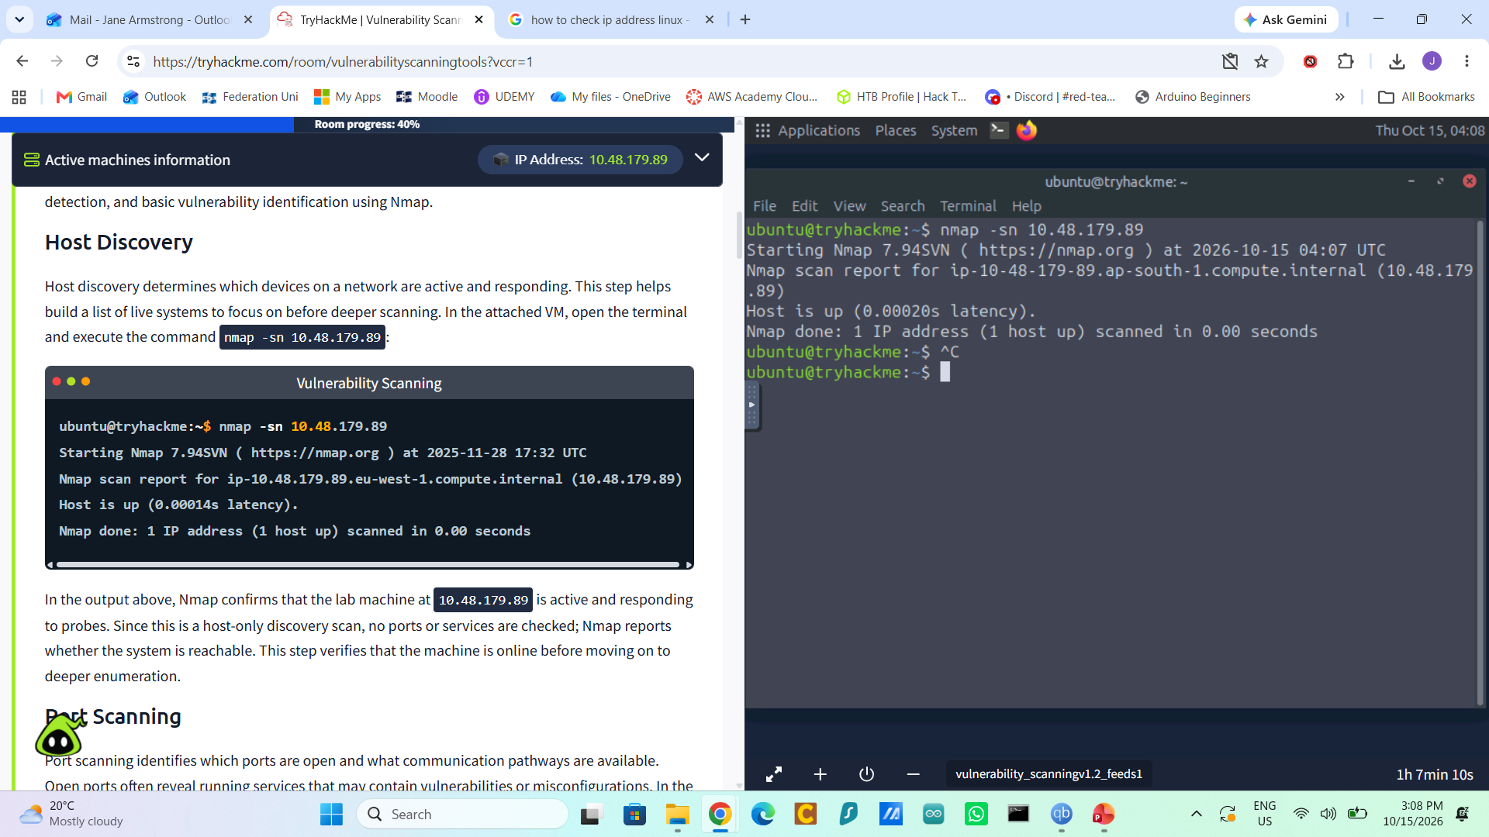
NMAP • HOST DISCOVERY
Nmap -sn: check whether the host is up
Command used
nmap -sn 10.48.179.89
What -sn means
Nmap performs host discovery and skips the normal port scan. It helps establish whether the target appears reachable.

Slide 7
NMAP • FINDINGS
Nmap -sn: what the result tells me
Host discovery answers a reachability question, it does not identify vulnerabilities.
Finding
Interpretation
Limitations
Nmap reported 10.48.179.89 as up in the latest host-discovery screenshot.
The target responded to Nmap’s discovery probes, indicating it was reachable at the time of the scan.
A host-up result does not prove that every service is available, nor does it show whether the host is vulnerable.

Slide 8
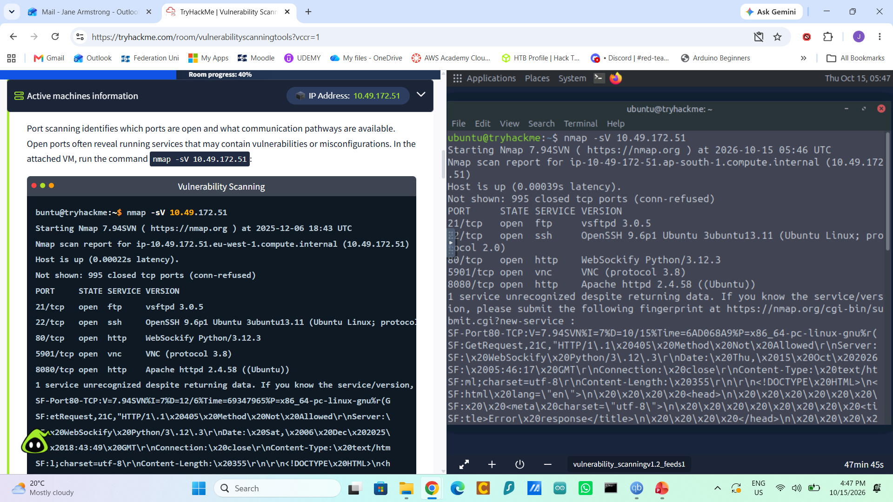
NMAP • SERVICE DETECTION
Nmap -sV: identify open ports and service versions
The service scan provided a more detailed view of the host than host discovery alone.
Command used
nmap -sV 10.49.172.51
What -sV does
Probes open ports to help identify the service and version running behind each port.

Slide 9
NMAP • FINDINGS
Nmap -sV: services observed
The earlier scan reported five open TCP ports on 10.49.172.51.
Open ports and detected services
What this means
21/tcp — FTP, vsftpd 3.0.5
22/tcp — SSH, OpenSSH 9.6p1
80/tcp — HTTP, WebSockify Python/3.12.3
5901/tcp — VNC (protocol 3.8)
8080/tcp — HTTP, Apache httpd 2.4.58 (Ubuntu)
• FTP, SSH, web and VNC services were exposed on the scanned host.
• Service/version details help defenders check patch status and whether access is necessary.
• Open ports are not automatically vulnerabilities; each service needs context and validation.
IP note: 10.49.172.51 was the address at scan time; after the VM restart, the current address shown was 10.48.191.167.

Slide 10
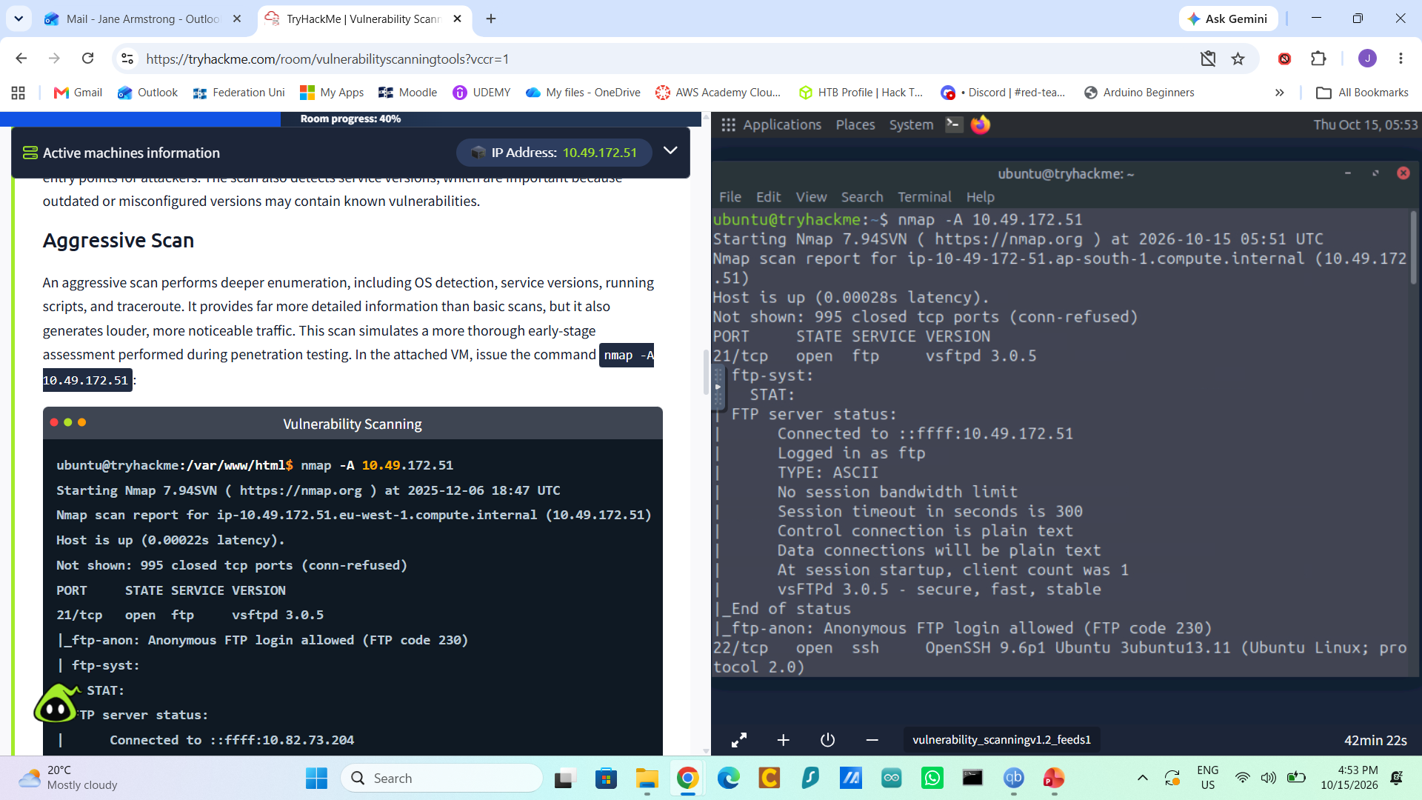
NMAP • AGGRESSIVE SCAN
Nmap -A: deeper host and service scan
The -A option combines several detection techniques for a deeper view of the lab host.
Command used
nmap -A 10.49.172.51
What -A enables
Enables OS detection, version detection, default NSE scripts and traceroute. It can reveal more context than -sn or -sV alone.

Slide 11
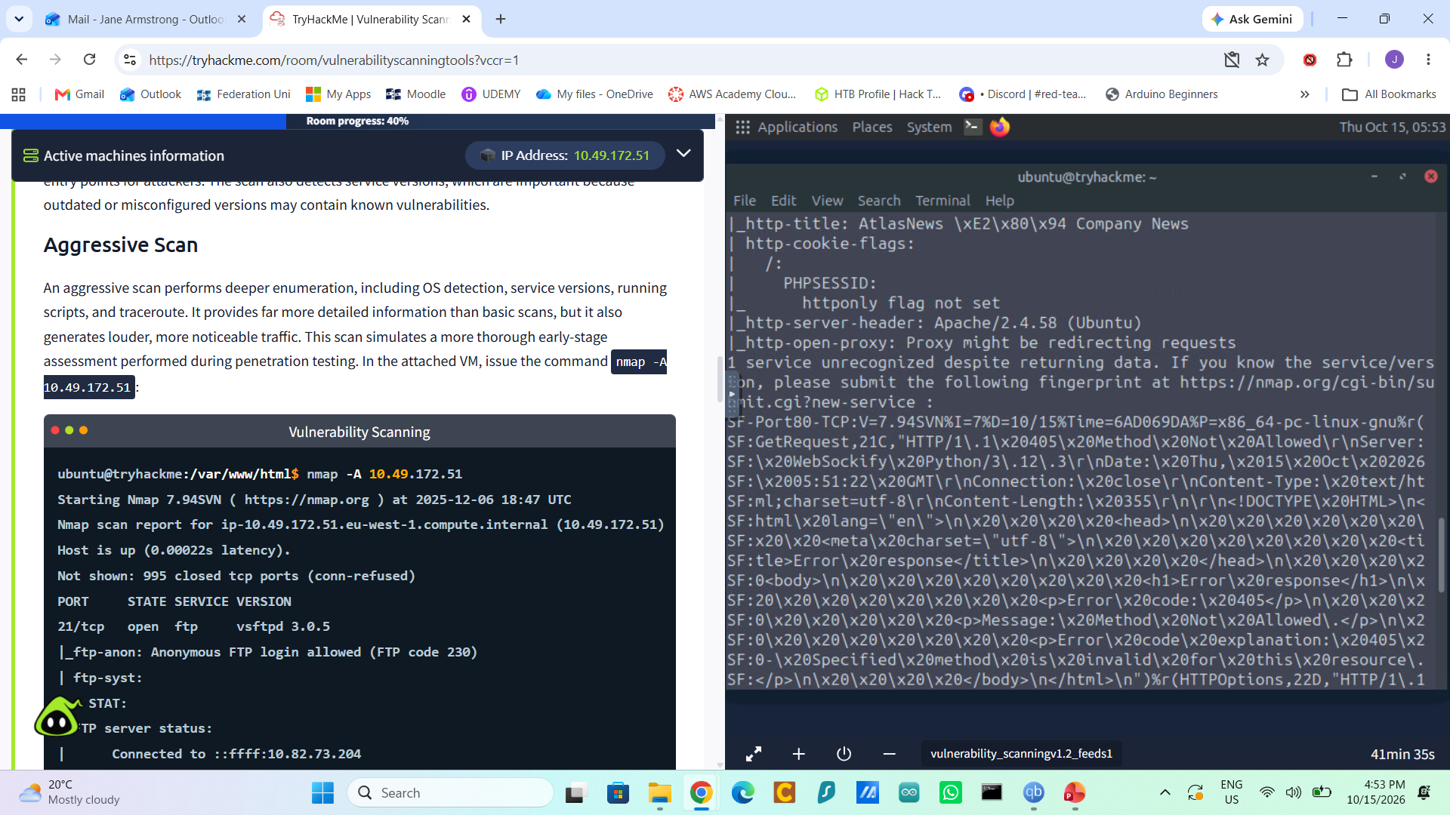

NMAP • FINDINGS
Nmap -A: observed results
The scan identified reachable services and returned additional service and HTTP script information.
Observed results
• Host 10.49.172.51 was up; 995 TCP ports were reported closed.
• 21/tcp: FTP, vsftpd 3.0.5; anonymous FTP login was allowed.
• 22/tcp: SSH, OpenSSH 9.6p1 Ubuntu.
• HTTP-related script output reported Apache/2.4.58 (Ubuntu), a PHP session cookie without the HttpOnly flag, and an HTTP method response.

Slide 12
NMAP • FINDINGS
Nmap -A: what the findings mean
What the findings mean
• Anonymous FTP may expose files to unauthenticated users; confirm whether access is necessary and restrict it if not.
• Service banners can reveal software versions, helping identify patching needs
• A PHP session cookie without the HttpOnly flag may be more exposed if client-side scripts are compromised.
• Treat script output as leads to look into, not automatic proof of exploitability.
Screenshots provide supporting evidence for the fidings.

Slide 13
RESULTS • NMAP
Nmap: observed results and what they mean
Observed results
What the results mean
• nmap -sn 10.48.179.89: Nmap reported “1 host up”.
• nmap -sV 10.49.172.51: five open TCP ports were reported.
• nmap –A 10.49.172.51: specific information about potential vulnerabilities such as unauthorised FTP access
• The -sn result indicates the host responded to discovery probes at that tim. It does not scan ports.
• The -sV result helps identify which services may need access controls, patch checks or removal.
• The –A result shows several points of exposure which may be exploited

Slide 14
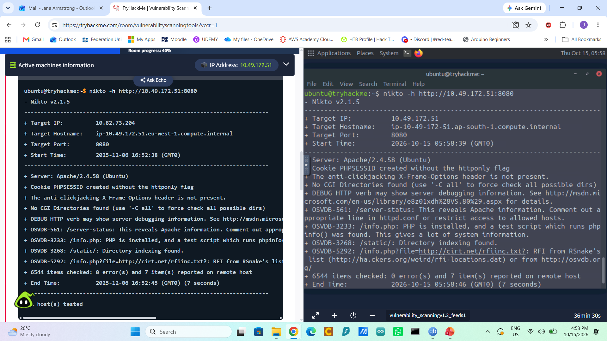
NIKTO • WEB SERVER SCAN
Nikto: check the web service on port 8080
Nikto checks for common web-server files, configuration weaknesses and information-disclosure issues.
Command used
nikto -h http://10.49.172.51:8080
Scan scope
The scan targeted HTTP on port 8080, where the service banner identified Apache 2.4.58 (Ubuntu).

Slide 15
RESULTS • NIKTO
Nikto: observed results and what they mean
Nikto checked the web service at http://10.49.172.51:8080 and reported potential web-server issues.
Observed results
What the results mean
• 6,544 items checked; seven items reported.
• /info.php exposed a PHP information page.
• Directory indexing was found at /static/.
• The PHP session cookie lacked the HttpOnly flag.
• X-Frame-Options was absent, /server-status may expose Apache details.
• A possible RFI-related pattern was reported for an info.php parameter.
• Diagnostic pages and server-status output may disclose configuration details.
• Directory listing can reveal files not intended to be browsed.
• Cookie flags and browser-security headers add protection, but their absence alone does not prove compromise.
• Restrict or remove unnecessary pages, disable directory listing, set suitable headers and cookie flags, and manually verify the RFI-related alert.

Slide 16
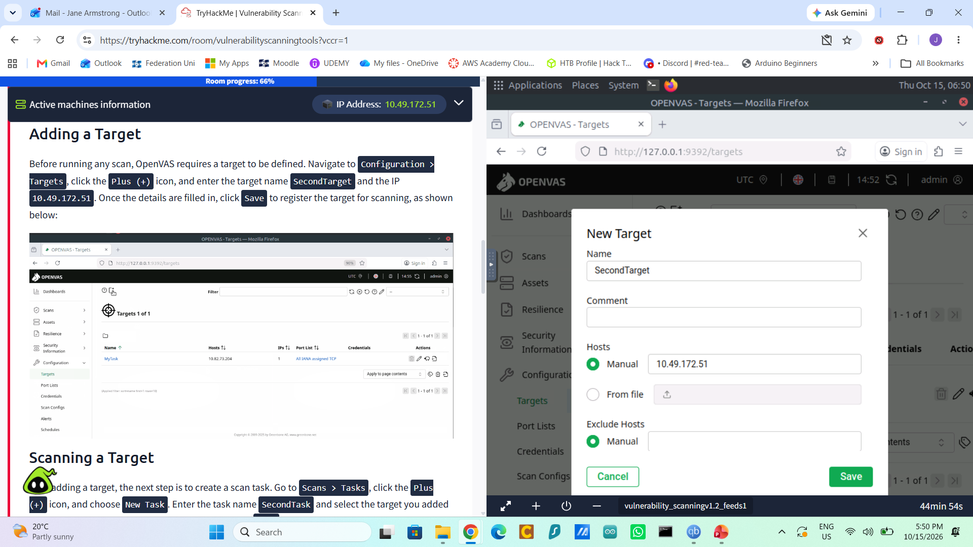
OPENVAS • TARGET SETUP
OpenVAS: add a scanning target
A target tells OpenVAS which host or IP address a scan should assess.
Steps followed
Open Configuration > Targets, select the + icon, then create a target named SecondTarget.
Target details
Choose Manual under Hosts and enter the lab VM's current IP address. In the screenshot, the target IP is 10.49.172.51. Select Save to register it.
Why this matters
Stores the host details for a scan.

Slide 17
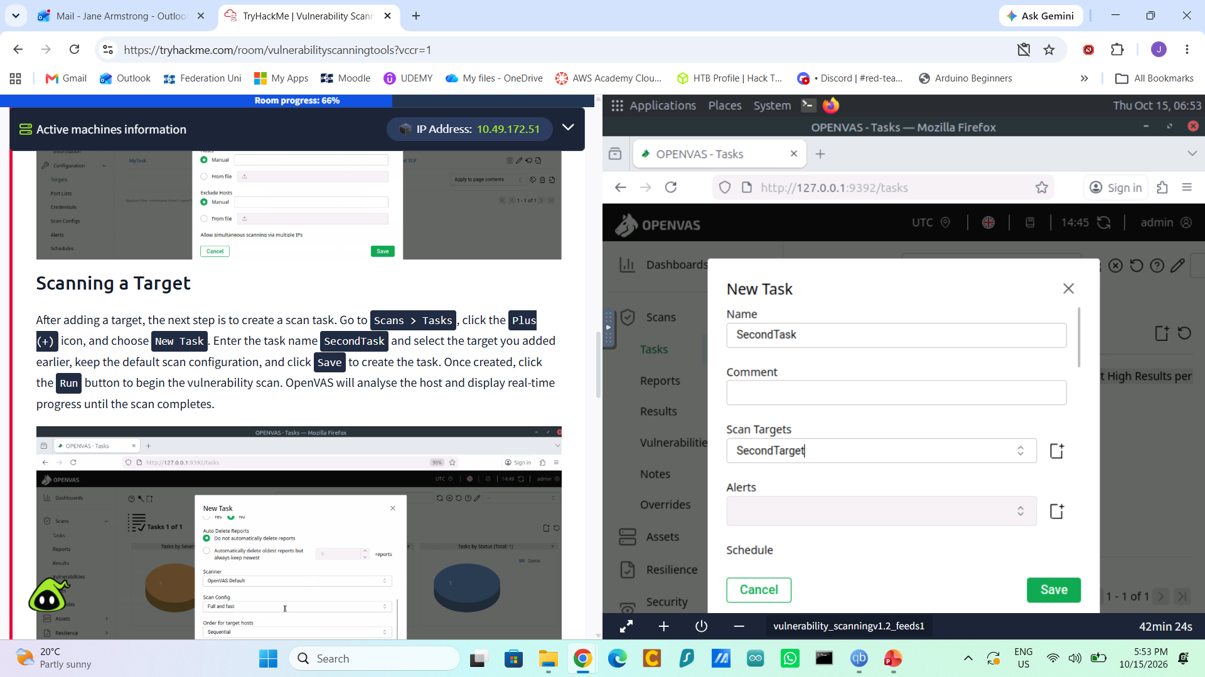
OPENVAS • TASK SETUP
OpenVAS: create a scan task
A task connects the target to a scan configuration and lets OpenVAS manage the assessment.
Steps followed
Go to Scans > Tasks, select the + icon, and choose New Task.
Task details
Name the task SecondTask and select SecondTarget under Scan Targets. Keep the default scan configuration and select Save.
Run and review
Click Run and review the report. Feed syncing may prevent a fresh scan in this room, so use the supplied MyTarget report for the questions.

Slide 18
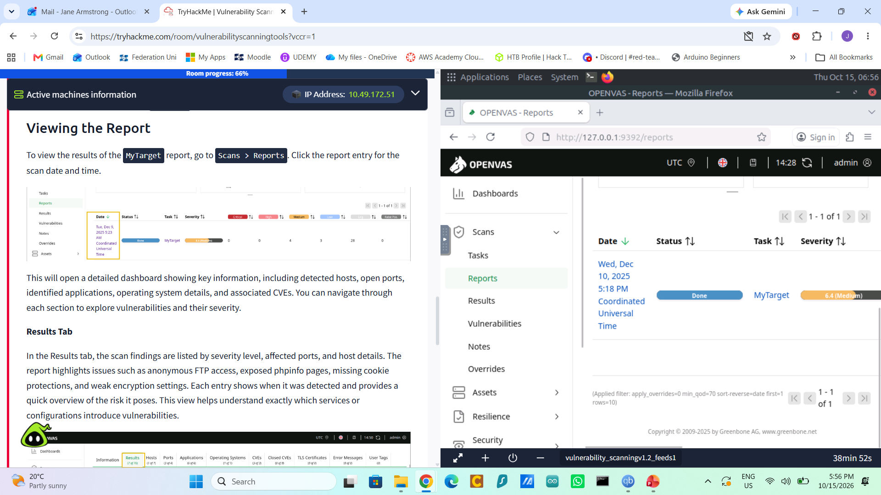
OPENVAS • REPORT REVIEW
OpenVAS: review the supplied vulnerability report
The room notes that a fresh scan may not run because vulnerability feeds need an active internet connection.
Workflow followed
Open Scans > Reports, then select the pre-scanned MyTarget report.
Important limitation
I reviewed the supplied report rather than completing a new scan. The report’s host differs from the temporary IP used in the Nmap/Nikto commands.

Slide 19
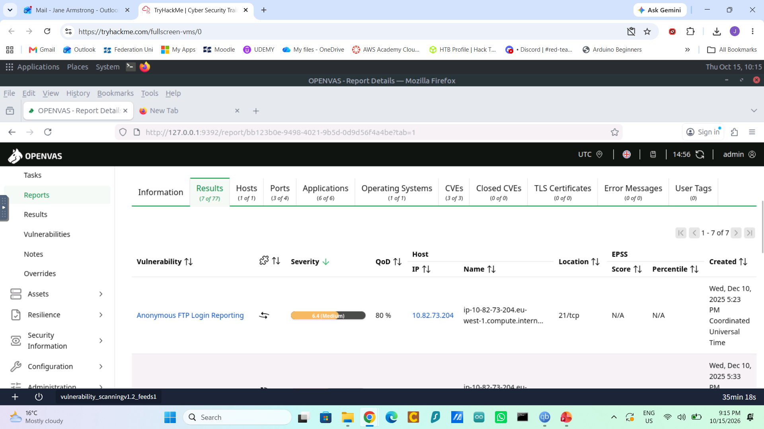
OPENVAS • REPORT EVIDENCE
OpenVAS report: results overview
The Results tab lists the findings detected in the supplied MyTarget scan.

Slide 20
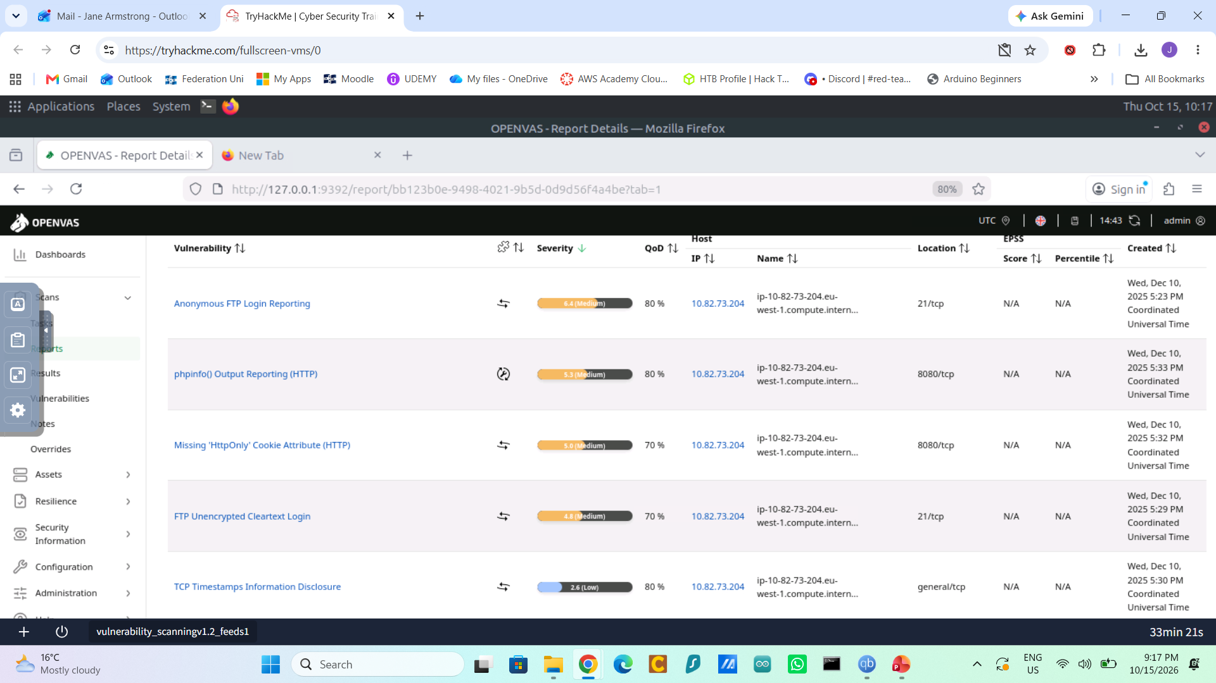
OPENVAS • REPORT EVIDENCE
OpenVAS report: full results table
The expanded view makes the individual findings and severity ratings easier to compare.

Slide 21
RESULTS • OPENVAS
OpenVAS: observed results and what they mean
This analysis uses TryHackMe’s pre-scanned MyTarget report, not a new scan run by me.
Observed results
What the results mean
• Report status: Done; overall severity score 6.4 (Medium).
• phpinfo() Output Reporting (HTTP): 5.3 (Medium).
• Anonymous FTP Login Reporting: CVE-1999-0497.
• Operating system reported: Ubuntu 24.04.
• Other results included missing HttpOnly cookie protection, FTP cleartext login and TCP timestamp information disclosure.
• Report host: 10.82.73.204.
• OpenVAS groups findings by severity and can link issues to published CVEs to support prioritisation.
• Anonymous FTP may allow file access without individual accounts. Disable it if not required.
• Public phpinfo pages can reveal system configuration. Restrict access.
• Cleartext FTP can expose credentials in transit. Use encrypted alternatives.
• Validate findings and prioritise based on severity, exposure and context.

Slide 22
REFLECTION
What I learned
Technical learning
Professional growth
Next time
Nmap helped me identify reachable services, while Nikto highlighted web-server configuration concerns. OpenVAS showed how findings can be grouped by severity and linked to known CVEs.
I was surprised how few simple commands and scans can reveal a lot about a system’s potential weaknesses
As I am wanting to become a Cybersecurity Analyst, these tools can help teach how to use practical skills to spot possible weaknesses, and provide evidence for remediation. Findings still need validation before being treated as confirmed vulnerabilities.
I learned to check the target IP after a VM restart because lab addresses can change. The OpenVAS exercise provided a pre-scanned report to review, it would be good to do a live scan to dig in to this tool further. I would like to find more TryHackMe modules that continue exploration of these tools further.
Notes:
Give a genuine reflection: what you learned, a challenge you faced, how you handled it, and what you would do differently.

Slide 23
CONCLUSION
Conclusion
Nmap identified exposed services on the authorised lab host. Nikto reported web-server configuration and information-disclosure concerns. The provided OpenVAS report showed how findings are assigned severity and linked to CVEs.
The key lesson is to scan only authorised targets, keep scope and evidence clear, validate findings, and prioritise proportionate fixes. A scanner report guides investigation, it does not by itself prove exploitation.
Questions?
Notes:
Summarise the main lesson and show your portfolio link. Keep within the required presentation time.

